Slide 1
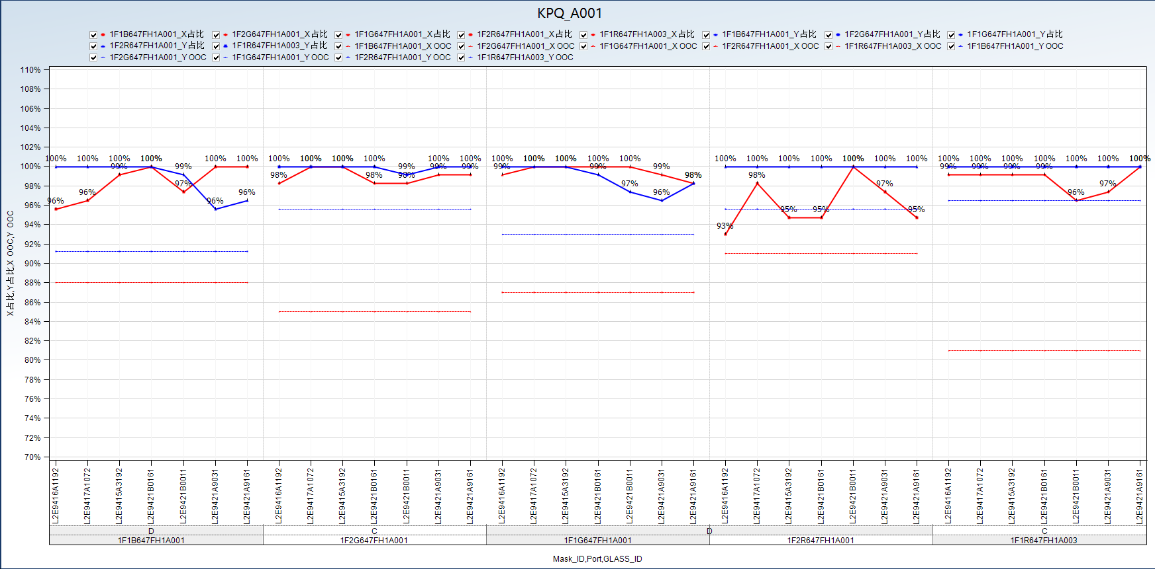
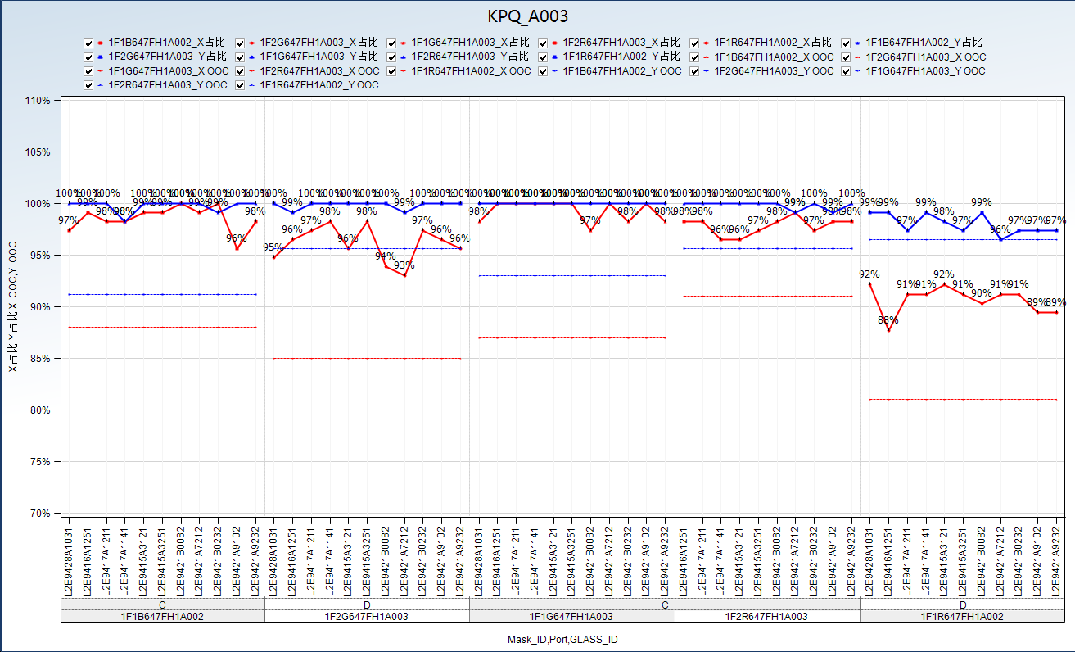
result
offset
PPA
Alarm
汇总数据
647FB
639QB
。。。

Slide 2
result
offset
PPA
Alarm
汇总数据
Group
Mask_ID | Port | Offset_X | Offset_Y | θ
1F1B647FH1A001 | D | 1 | 1 | 10

Slide 3
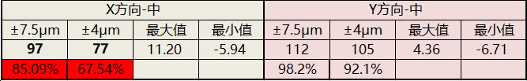
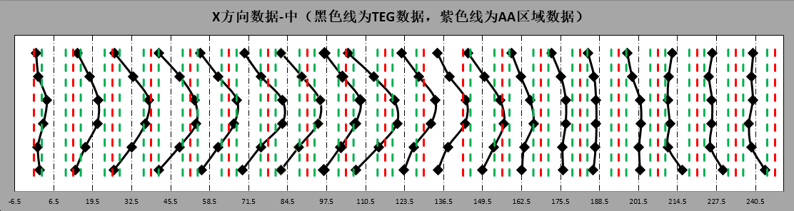
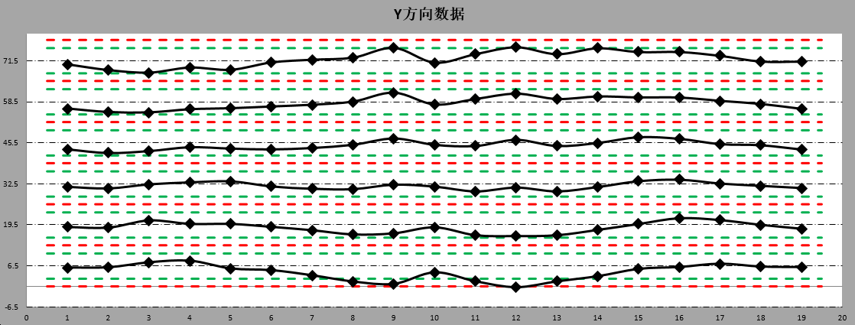
result
offset
PPA
Alarm
汇总数据
Glass_ID
Chamber
√
offset

Slide 4
result
offset
PPA
Alarm
汇总数据
Reset
ITEM | value |  | Time
PPA | L2E930A2142 | 1F1B647FH1A001 PPA out of Spec：PPA_X 78.5%！ | 2019.05.31 10:34
Offset | 1F1B647FH1A001 | 1F1B647FH1A001 offset change out of Spec： offset_X 0.5->4 | 2019.05.31 10:34

Slide 5
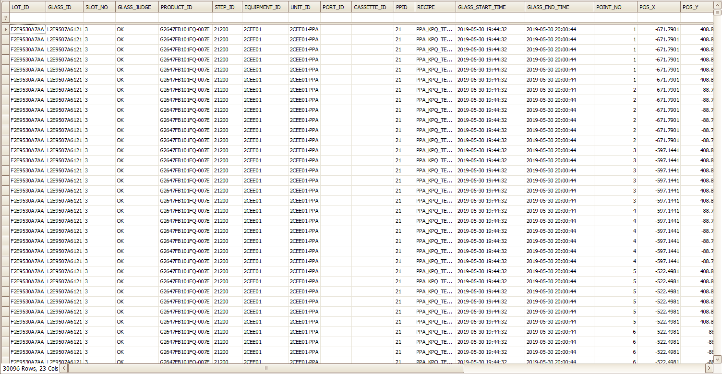
result
offset
PPA
Alarm
汇总数据
原始数据展示3天即可

